Slide 1


Slide 2


Early Student Performance Prediction Using Educational Data Mining
Final Year Project Progress
Submitted by
ROLL | NAME
2301840009 | Mansi Rawat
2301840005 | Sahil Parasar
Faculty Mentor: Dr. Meenu
Notes:
New Courses replaced with New Programmes

Slide 3




Project Overview
Early Student Performance Prediction Using Educational Data Mining
An Actionable Early-Warning System with Six-Class Grading
Notes:
New Courses replaced with New Programmes

Slide 4




Specific Objectives
Input Data (Demographics + Behavior)
Specific Objectives
Feature Engineering
Early prediction using only pre-midterm behavioral and demographic data
Clustering
No dependency on exam scores
Six-class grading system (A, B, C, D, E, F)
Ensemble Models
Early-alert dashboard with actionable recommendations
High recall for failing students (F-grade detection)
Hybrid Classifier
Model explainability using SHAP values
Six-Class Prediction
Scalable and deployable system architecture
Dashboard + Alerts
Notes:
New Courses replaced with New Programmes

Slide 5










Key Features
Early prediction without exam data
effective_study_time feature
KMeans clustering
Ensemble regression
Engineered metric combining study duration and engagement quality
Groups students into behavioral patterns for targeted modeling
Combines Random Forest, Gradient Boosting, and XGBoost for score prediction
Uses only pre-midterm behavioral and demographic features
Hybrid classifier
Ordinal probability boosting
Six-class grading system
Early-warning dashboard
Integrates predicted_score as a feature for grade classification
Respects grade ordering (A > B > C > D > E > F)
Provides granular performance categories
Visual interface with risk levels and personalized recommendations
Notes:
New Courses replaced with New Programmes

Slide 6
Progress Summary
End-to-end pipeline completed: Full workflow from data to dashboard operational
7 models implemented: KMeans, 3 regressors, hybrid classifier, ordinal boosting, ensemble
84.60% accuracy achieved: High performance on six-class grade prediction
Dashboard developed: Interactive early-warning system with recommendations
SHAP analysis completed: Model interpretability and feature importance identified
Visualizations created: Comprehensive charts for results and insights
Status: Completed & Ready for Submission
Project Status
100% Complete
Notes:
New Courses replaced with New Programmes

Slide 7



Detailed Progress – Development Phase
Data cleaning & feature engineering
1
Preprocessing, scaling, encoding, and creating effective_study_time
2
Feature selection
Identifying most predictive behavioral and demographic variables
KMeans clustering
3
Segmenting students into behavioral groups
4
Ensemble regression
Training RF, GB, XGBoost to predict numerical scores
Hybrid classifier
5
Building grade classifier using predicted_score as input
6
Ordinal boosting
Implementing ordinal regression for grade ordering
Dashboard creation
7
Developing interactive visualization and alert system
8
SHAP & visualization
Generating explainability analysis and result charts
Notes:
New Courses replaced with New Programmes

Slide 8








Methodology
Dataset
Dataset
15,000 student records with behavioral and demographic features
Preprocessing
Scaling numerical features, encoding categorical variables, feature engineering
Preprocessing
Clustering
KMeans algorithm to identify student behavioral patterns
Clustering
Modeling pipeline
Ensemble Regression → Predicted Score → Hybrid Classifier → Ordinal Boosting
Regression Models
Evaluation
80/20 train-test split with cross-validation
Classifier
Output
Six-class grades (A-F) + risk levels + personalized recommendations
Grades / Alerts
Notes:
New Courses replaced with New Programmes

Slide 9
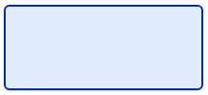
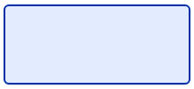




Prototype/Project Flow diagram/Architecture
End-to-end automated prediction system
Raw Data
Data Cleaning
Feature Engineering
From raw data to actionable insights.
Hybrid Classifier
Ensemble Regression
KMeans Clustering
Data Stages
(RF + GB + XGBoost)
Modeling Stages
Output Stages
Early-Warning Dashboard
Ordinal Boosting
Six-Class Grades
(Risk Levels + Recommendations)
Notes:
New Courses replaced with New Programmes

Slide 10









Project Timeline
Phase
W1
W2
W3
W4
W5
W6
W7
W8
W9
W10
Data collection, cleaning, and analysis
Feature engineering & study_time
KMeans clustering & patterns
Ensemble regression development
Hybrid classifier implementation
Ordinal boosting & optimization
Dashboard development & integration
SHAP analysis & visualization
Testing, validation, & documentation
Comprehensive 10-week development cycle covering the full machine learning pipeline from raw data to actionable dashboard.
Parallel work on model optimization and visualization ensures high accuracy (84.60%) and interpretability via SHAP.
Notes:
New Courses replaced with New Programmes

Slide 11
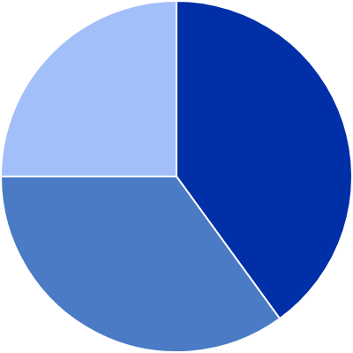
Data & Resources
Dataset
15,000 student records from learning management system
Features
Login frequency, study duration, assignment submissions, forum participation, video views, demographics (age, gender, prior GPA)
Exclusions
No mid-term or exam scores used for prediction
Tools
Python 3.9, scikit-learn, XGBoost, pandas, matplotlib, seaborn, SHAP
Infrastructure
Jupyter Notebook, GitHub version control
Feature Category Distribution
Behavioral (40%)
Engagement (35%)
Demographic (25%)
Notes:
New Courses replaced with New Programmes

Slide 12
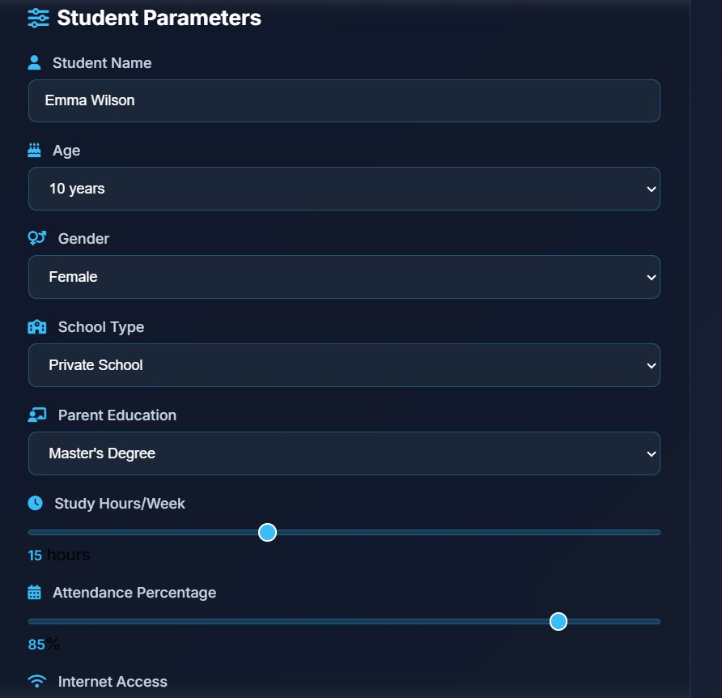


Project Use cases & Scope
Early risk detection: Identify struggling students before midterm exams
Personalized recommendations: Tailored interventions based on behavioral patterns
Classroom dashboard: Real-time monitoring for instructors and advisors
Scalable for institutions: Adaptable to different course sizes and disciplines
Institutional analytics: Aggregate insights for curriculum improvement
Scope: Pre-midterm prediction only (Weeks 1-6 of semester)
Limitation: Requires consistent LMS data collection and student engagement tracking
Notes:
New Courses replaced with New Programmes

Slide 13

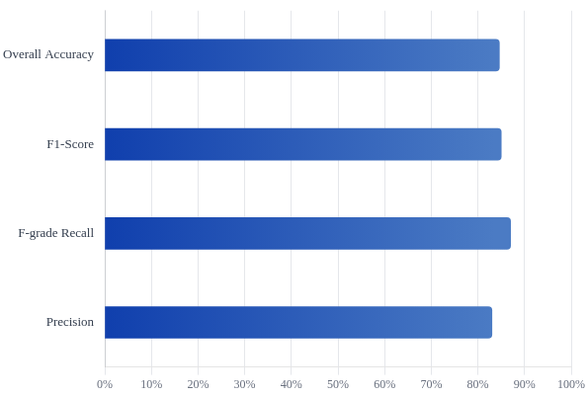
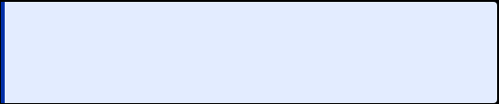
Expected Results & Impact
84.60%
0.85
Performance Metrics Overview
Overall Accuracy
F1-Score
on six-class grade prediction
(weighted average across all grade classes)
0.87
6,422
F-grade Recall
High-Risk Students Identified
(high detection rate for at-risk students)
students flagged for early intervention
Impact: Enables proactive academic support, reduces dropout rates, improves student success outcomes, and provides data-driven insights for institutional decision-making
Notes:
New Courses replaced with New Programmes

Slide 14





THANK YOU

